Slide 1
Safety Training Companies are Required to Have
Safety Compliance Associates, LLC

Slide 2
Objectives
Training sessions will:
  Identify the type of training is required for employee(s)
  Identify the training requirements for OSHA 2013 Top 10 Most Frequently Cited Standards

Slide 3
Training Obligation
More than 100 OSHA standards require training in the safety and health aspects of their jobs.
Reflect OSHA’s belief that training is an ESSENTIAL part of every employers safety and health program.

Slide 4
What OSHA Requires
  OSHA requires documentation:
    Review by OSHA Compliance Officer
    Assures that initial or periodic training is accomplished with established time frames.

Slide 5
Safety Training Does OSHA Require Annually?
General Industry 29 CFR 1910 rules include annual retraining of employee:
  Access to employee exposure and medical records
    29CFR1910.1020
  Bloodborne Pathogens – 29CFR1910.1030
  Fire Brigades – 29CFR1910.156
  Fixed Extinguishing Systems 29CFR1910.160
  Grain Handling Facilities 29CFR1910.272
  HAZWOPER 29CFR1910.120

Slide 6
Safety Training does OSHA Require Annually
Mechanical Power Presses – 29CFR1910.217
Occupational Noise – 29CFR1910.95
Permit – Required Confined Space – 29CFR1910.146
Portable Fire Extinguishers – 29CFR1910.157
Respiratory Protection – 29CFR1910.134

Slide 7
Top 10 Most Frequently Cited Standards 2013
Fall Protection (C) 1926.501
Hazard Communication 1910.1200
Scaffolding (C) 1926.451
Respiratory Protection 1910.134
Electrical 1910.305

Slide 8
Top 10 Most Frequently Cited Standards 2013
Powered Industrial Trucks 1910.178
Ladders (C) 1926.1053
Lockout/Tagout 1910.147
Electrical, General Requirements 1910.303
Machine Guarding 1910.212

Slide 9
Fall Protection
Train everyone to use the equipment safely
  Falls can be prevented when workers understand proper set-up and safe use of equipment, so they need to be training on specific equipment they will use to complete the job.
  Employers must train workers in hazard recognition and the care and safe use of:
    Ladders
    Scaffolds
    Fall protection systems
    Other equipment they’ll be using on the job

Slide 10
Fall Protection
OSHA enforces regulations in 1926, Subpart M for Construction, which require fall protection must be provided at 6 feet in Construction
Falls from ladders, scaffolds and roofs can be prevented and lives can be saved through three simple steps:
  Plan
  Provide
  Train

Slide 11
Fall Protection
Important – Regardless of the fall distance, fall protection must be provided when working over dangerous equipment and machinery

Slide 12
Training Requirements for Fall Protection Standard 1926.503
Retraining:
  Employee does not understand and skill required
  Changes in the workplace render previous training obsolete;
  Changes in the types of fall protection systems or equipment to be used render previous training obsolete;
  Inadequacies in an affected employee’s knowledge or use of fall protection systems or equipment indicated that the employee has not retained the requisite understanding or skill.

Slide 13
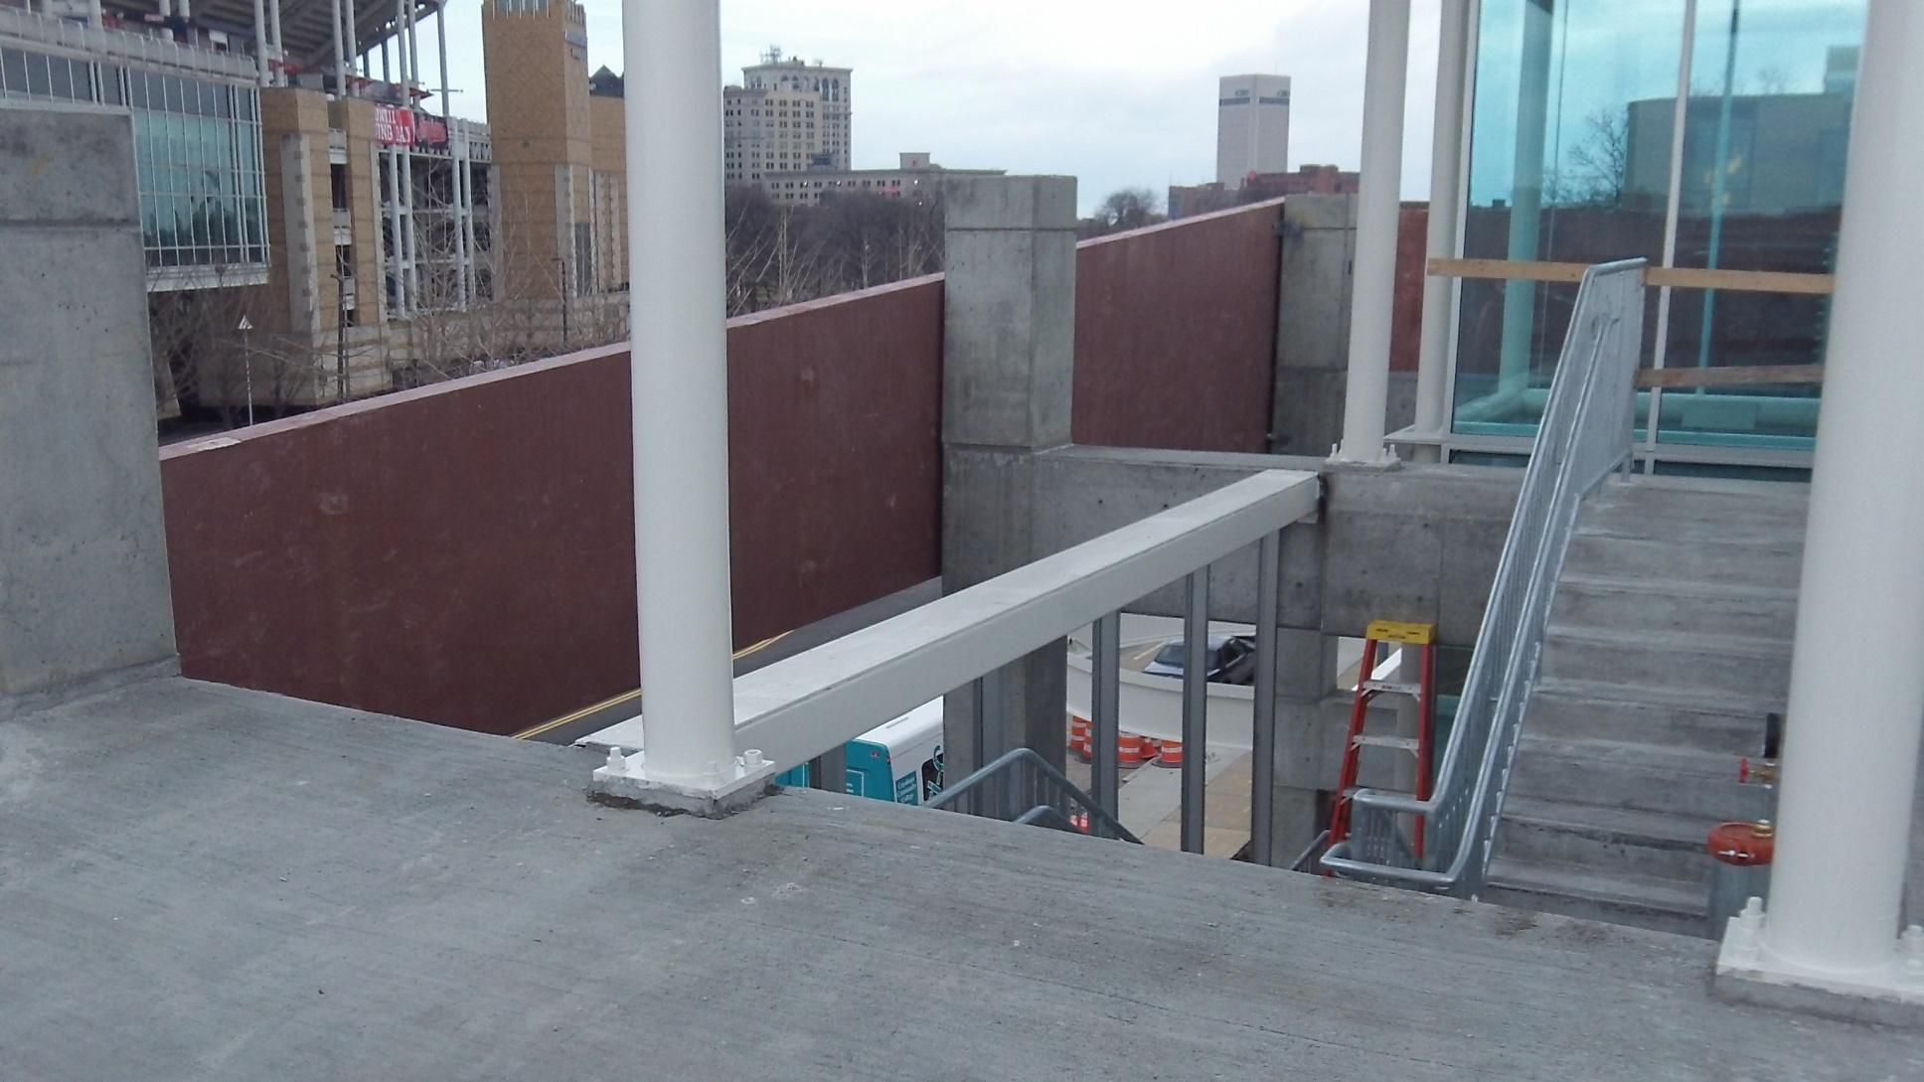
Lack of Fall Protection
No Guardrail

Slide 14
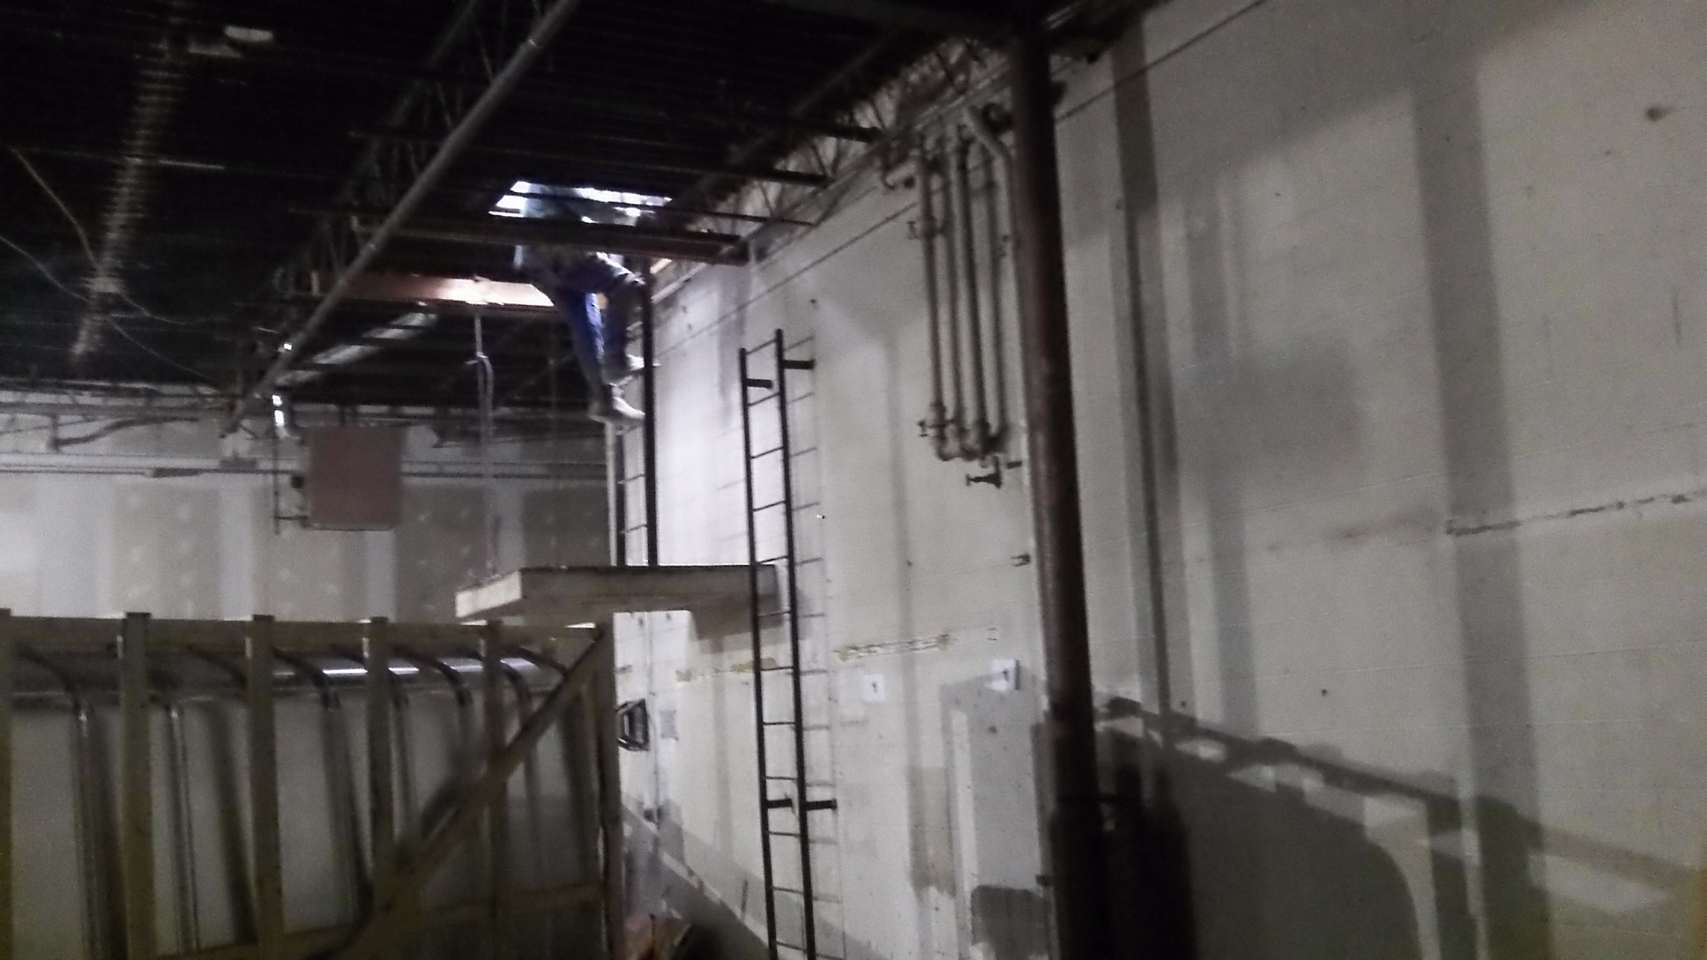
No Guardrail
Around Platform

Slide 15
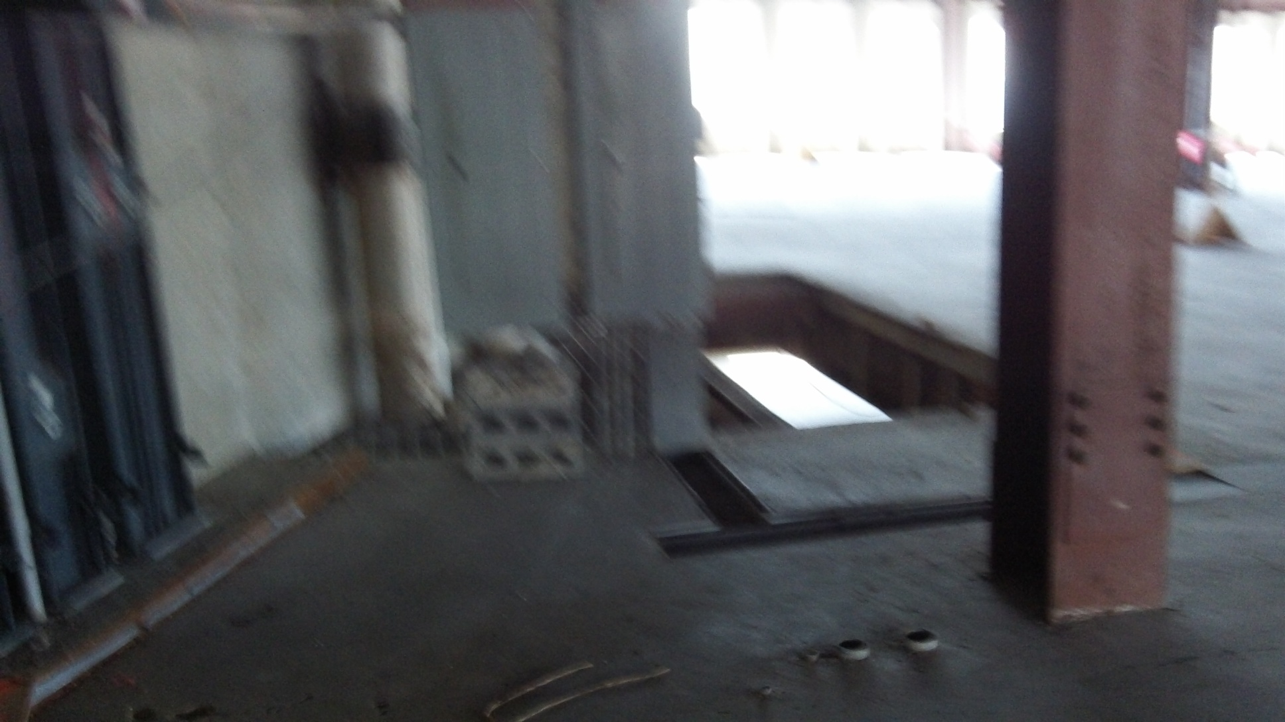
Hole

Slide 16
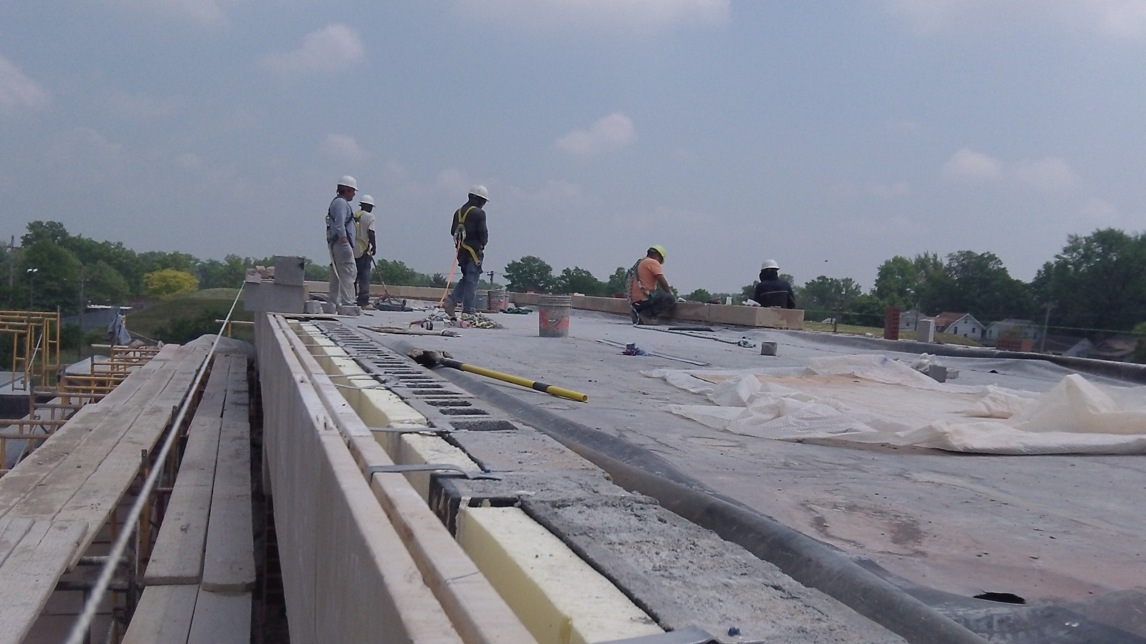
Fall Protection
Temporary Anchor Points Missing

Slide 17
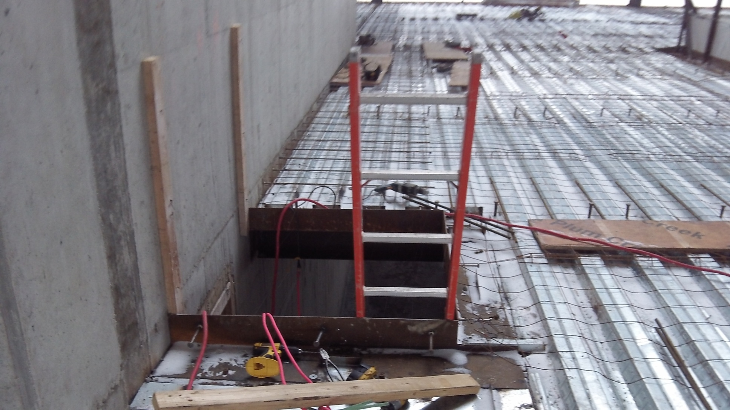
No Guardrail Around Floor Opening

Slide 18

Wire Rope

Slide 19
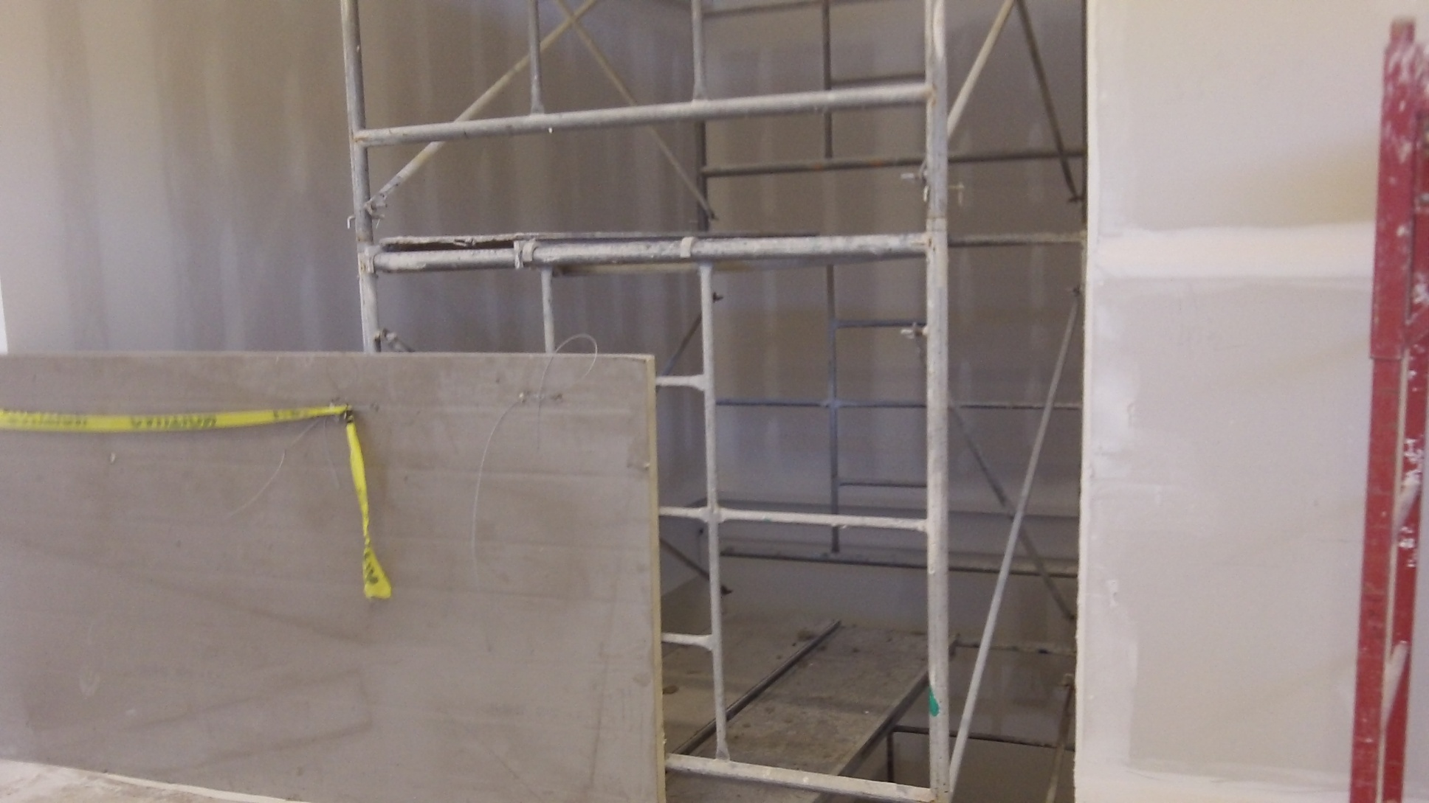
Improper Barricade at an Elevator Shaft

Slide 20

Reason for Fall Protection Training

Slide 21
Fall Protection
# 1 on OSHA’s Top 10 Most Frequently Cited Standards for FY 2013.
8,241 violations written (2013)
7,250 violations written (2012)
The employer shall provide a training program for each employee exposed to fall hazards.
Recognize the hazards of falling and shall train each employee in the procedures to be followed in order to minimize these hazards.

Slide 22
Hazard Communication
New hire – prior to actual work exposure
Training is event driven and not an annual requirement:
  Upon initial assignment
  Then whenever a new physical or health hazard is introduced.

Slide 23
Hazard Communication
Information required:
  The standard’s requirements
  The operations where hazardous chemicals are present
  The location and availability of the written HCP, including the lists of hazardous chemicals, and Safety Data Sheets (SDS)

Slide 24
Hazard Communication
Training Requirements
  How to detect the presence or release of hazardous chemical in the work area
  The physical and health hazards of the chemicals
  The measures to take to protect themselves from the hazards
  The details of the employer’s HCP

Slide 25

Old Lab Chemicals In Storage

Slide 26

Oil Not Properly Stored

Slide 27

Proper Training?

Slide 28

Good Storage Practices?

Slide 29
Hazard Communication
#2 on OSHA’s Top 10 Most Frequently Cited Standard for 2013
6,165 violations (2013)
4,696 violations (2012)
Failed to have a written program
Provide adequate employee education and training
To properly label (or have any label on) container
Provide workers with access to safety data sheets.

Slide 30
Scaffolding
Competent person is someone who has broad knowledge of worksite safety and health issues, capable of identifying existing and predictable worksite hazards, and who has management approval to control the hazards.
Competent person can supervise, moving, or dismantling scaffold at a worksite.

Slide 31
Scaffolding
Training Requirements: Employer shall have each employee who performs work while on a scaffold trained by a person qualified in the subject matter to recognize the hazards associated with the type of scaffold being used and to understand the procedures to control or minimize those hazards.

Slide 32
Scaffolding
Training shall include:
  The nature of any electrical hazards, fall hazards and falling object hazards in the work area;
  Correct procedures for dealing with electrical hazards and for erecting, maintaining, and disassembling the fall protection systems and falling object protection systems being used;
  The proper use of the scaffold, and the proper handling of materials on the scaffold;

Slide 33
Scaffolding
Training (cont’d)
  The maximum intended load and the load – carrying capacities of the scaffolds use; and
  Any other pertinent requirements of this subpart.
  Trained by competent person who is involved in erecting, disassembling

Slide 34
Scaffolding
Employer shall have each employee who is involved in erecting, disassembling, moving, operating, repairing, maintaining, or inspecting a scaffold trained by a competent person to recognize any hazards associated with the work in question. The training shall include the following topics, as applicable:

Slide 35
Scaffolding
  The nature of scaffold hazards;
  Correct procedures for erecting, disassembling, moving, operating, repairing, and inspecting, and maintaining the type of scaffold in question;
  The design criteria, maximum intended load – carrying capacity and intended use of the scaffold;
  Any other pertinent requirements of this subpart.

Slide 36
Scaffolding
When the employer has reason to believe that an employee lacks the skill or understanding needed for safe work involving the erection, use or dismantling of scaffolds, the employer shall retrain each such employee so that the requisite proficiency is regained. Retraining is required in at least the following situations:

Slide 37
Scaffolding
Where changes at the worksite present a hazard about which an employee has not been previously trained; or
Where changes in the types of scaffold, fall protection, falling object protection, or other equipment present a hazard about which an employee has not been previously trained; or
Where inadequacies in an affected employee’s work involving scaffolds indicate the employee has not retained the requisite proficiency.

Slide 38
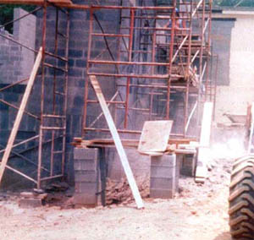
Need for Scaffold Training

Slide 39
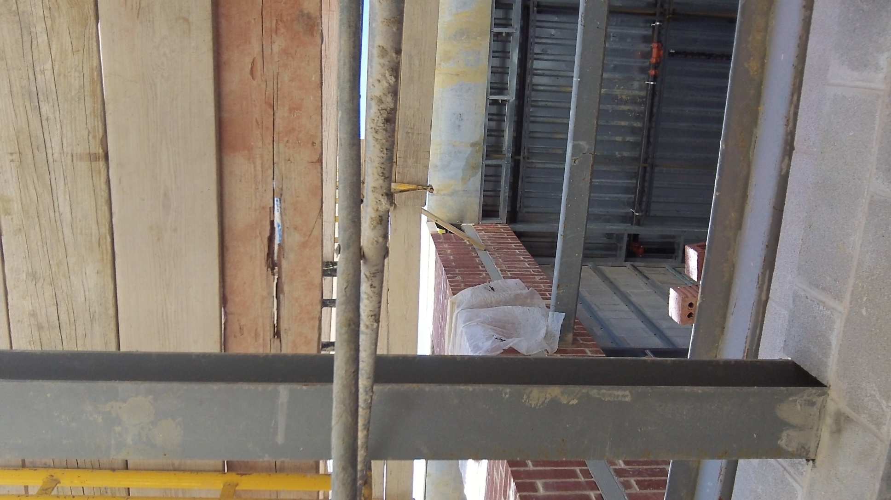
Poor Condition of Planking

Slide 40
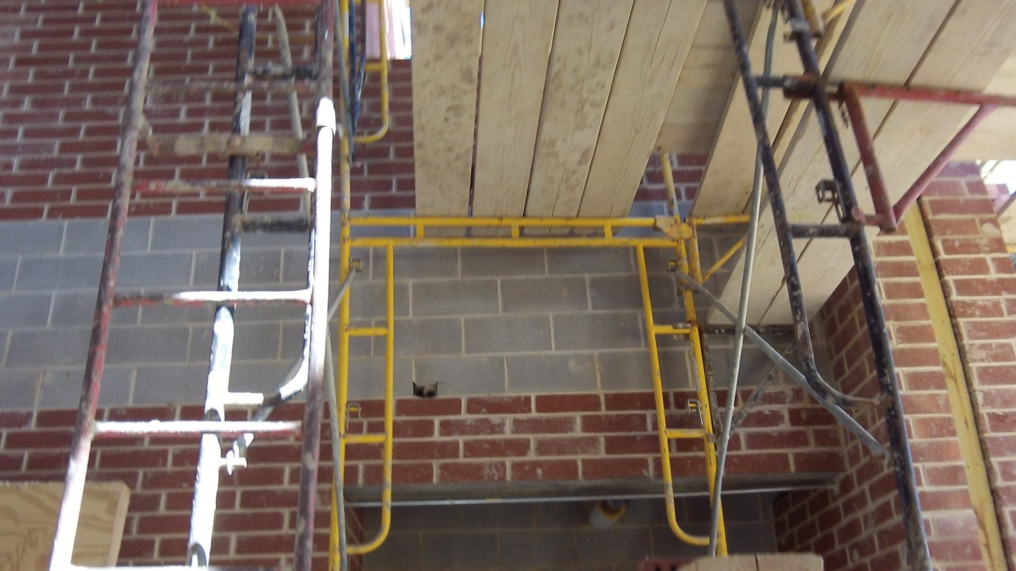
Not Fully Planked/Multiple Scaffolding

Slide 41
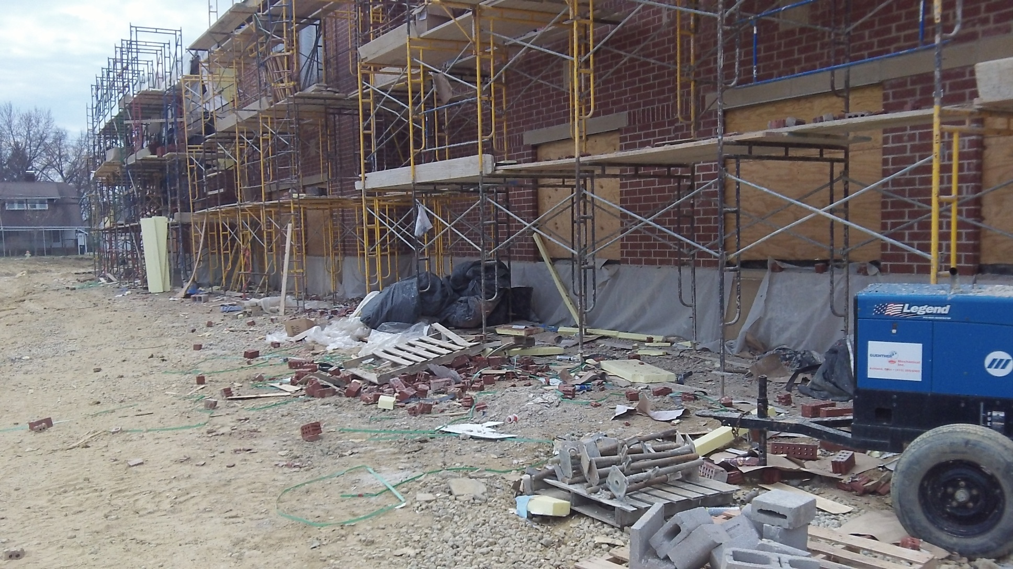
Clutter

Slide 42
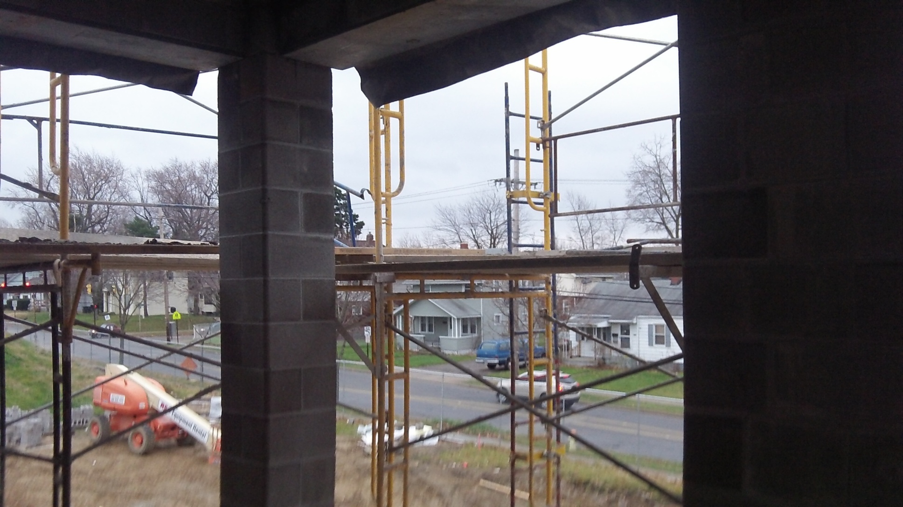
Scaffolding With No Fall Protection

Slide 43
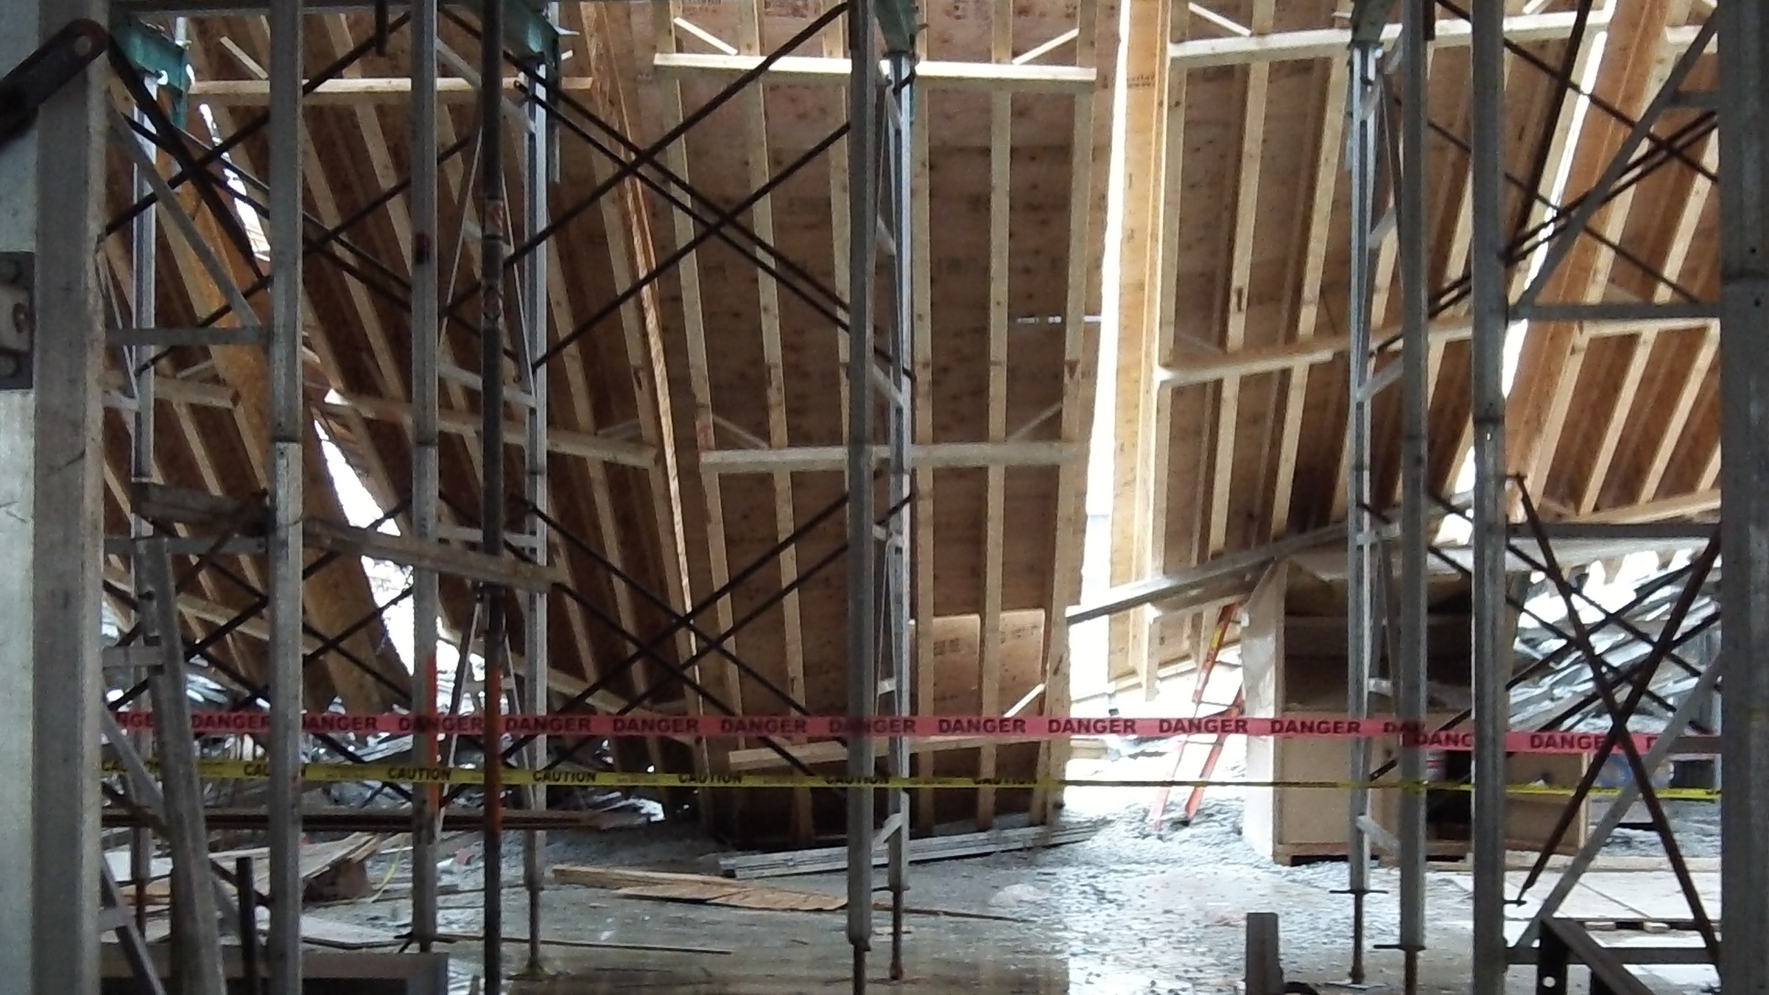
Scaffolding Collapse

Slide 44
Scaffolding
#3 On OSHA’s Top 10 Most Frequently Cited Standard for 2013
5,423 violations (2013)
3,814 violations (2012)
Problems with scaffold construction
Improper worker access
Lack of guardrails

Slide 45
Respiratory Protection
Training and Information
  Train all employees who are required to use respirators
  Train prior to required workplace respirator use.
  Must be comprehensive
  Provide the information in the standard’s Appendix D to employees who voluntarily wear respirators; can be oral or written

Slide 46
Respiratory Protection
Training occurs at least annually and covers:
  Why the respirator is necessary
  How improper fit, usage, or maintenance can compromise effectiveness
  Respirator limitations and capabilities
  Respirator use in emergencies
  How to inspect, put on and remove, use – and check the seal
  Maintenance and storage

Slide 47
Respiratory Protection
  Relevant medical signs and symptoms
  The general requirements of the respirator standard
  Retraining must occur annually or when the following situations occur:
    Changes in the workplace or the type of respirator make previous training obsolete
    Perceived inadequacies in the employee’s knowledge or use of the respirator
    Other situations that may impact safe respirator use

Slide 48
Respiratory Protection
Employer must establish and implement those elements of a written respiratory protection program.
Employer shall designate a program administrator who is qualified by appropriate training or experience.
The employer shall provide respirators, training, and medical evaluations at no cost to the employee.

Slide 49
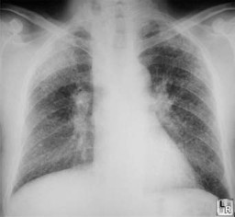
Lungs with Silicosis

Slide 50
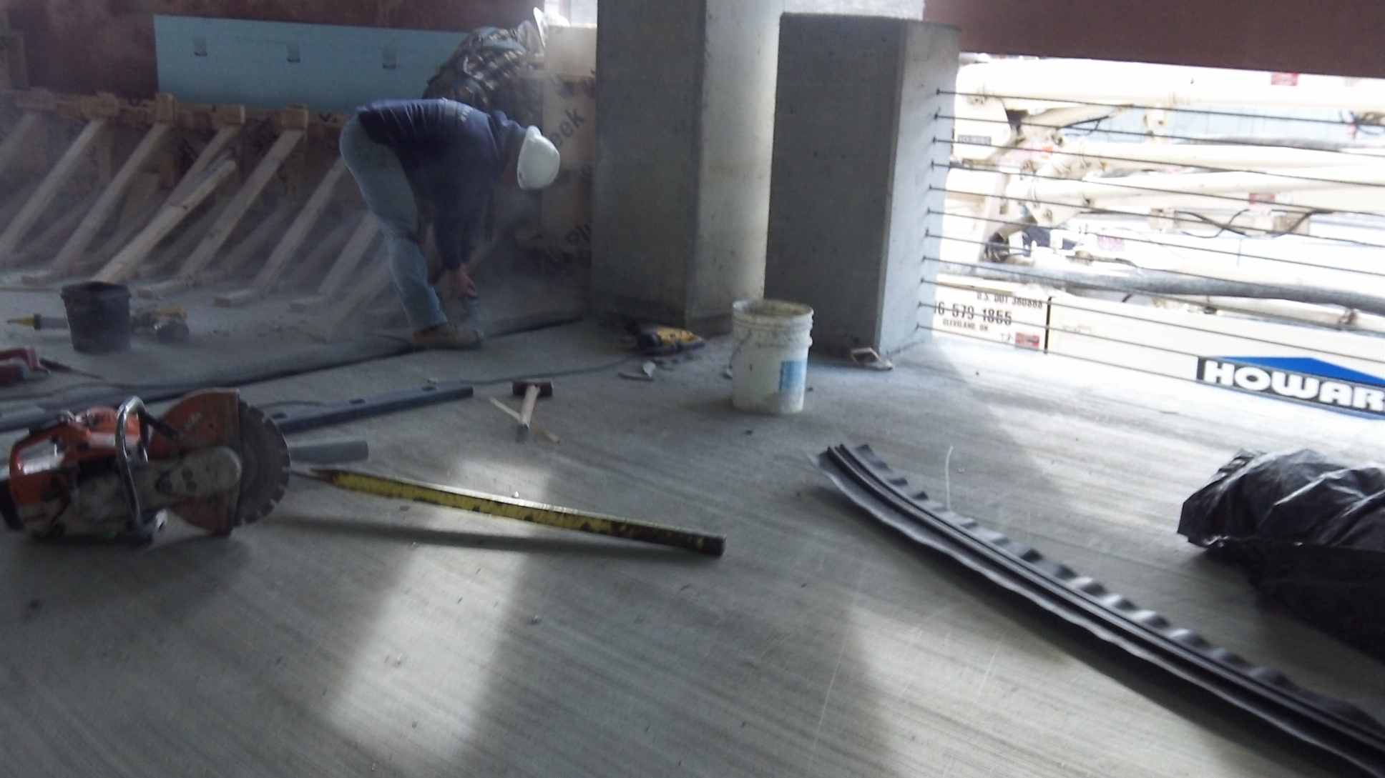
Dry Cutting Concrete Not Wearing Appropriate Respiratory Protection

Slide 51

Improper Respiratory Protection/Not Trained

Slide 52

Sanding Drywall/Not Trained

Slide 53
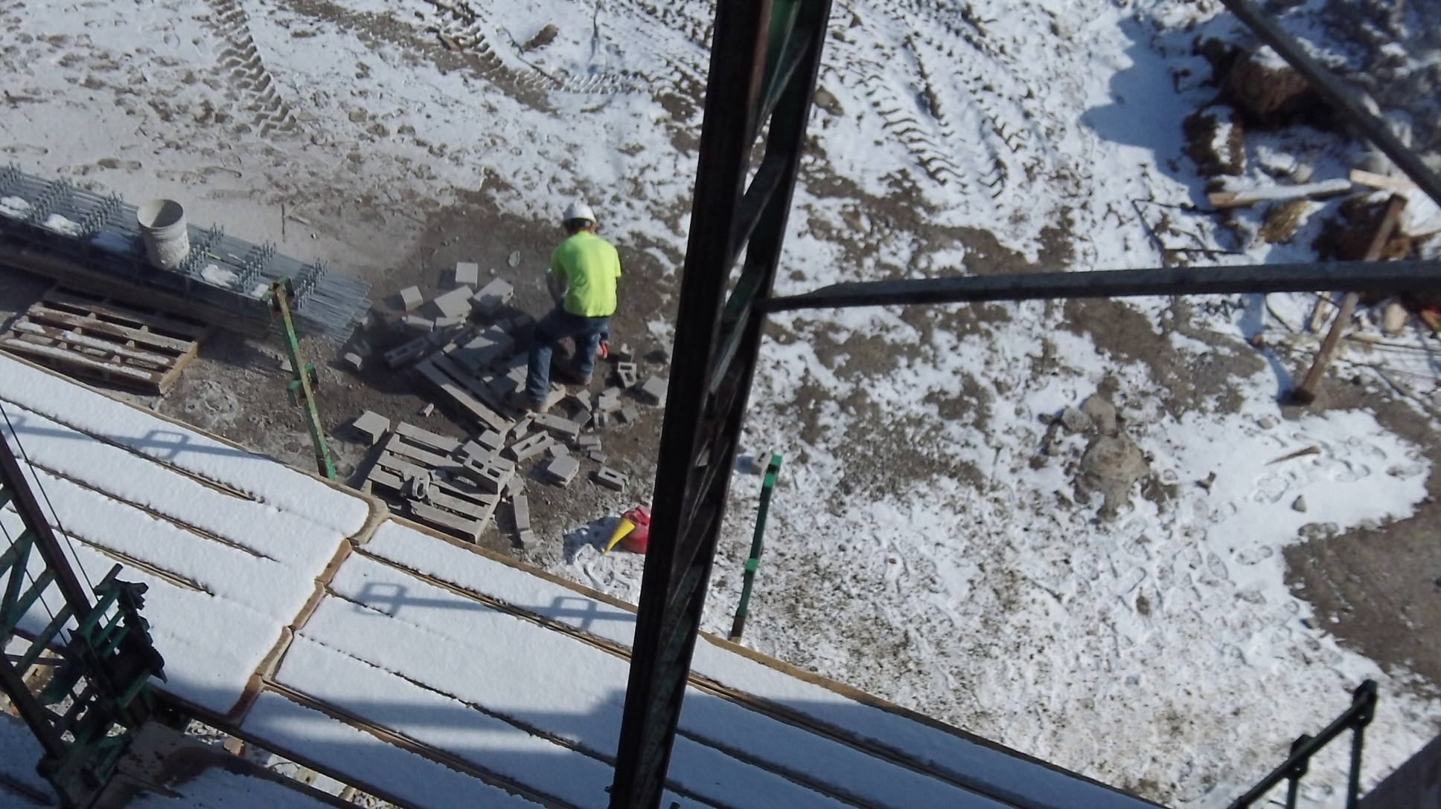
Dry Cutting Without Respiratory Protection

Slide 54
Respiratory Protection
#4 on OSHA’s Top 10 Most Frequently Cited Standard for 2013
3,879 Violations (2013)
2,731 Violations (2012)
No written respiratory protection program
Poor fit test procedures
Unsuitable respirator selection process
Not having procedures for voluntarily use of respirators

Slide 55
Electrical
#5 on OSHA’s Top 10 Most Frequently Cited Standard for 2013
3,245 Violations (2013)
2,371 Violations (2012)
Problems with flexible cords
Boxes and temporary wiring
Poor use of extension cords
Use of temporary wiring as permanent wiring

Slide 56
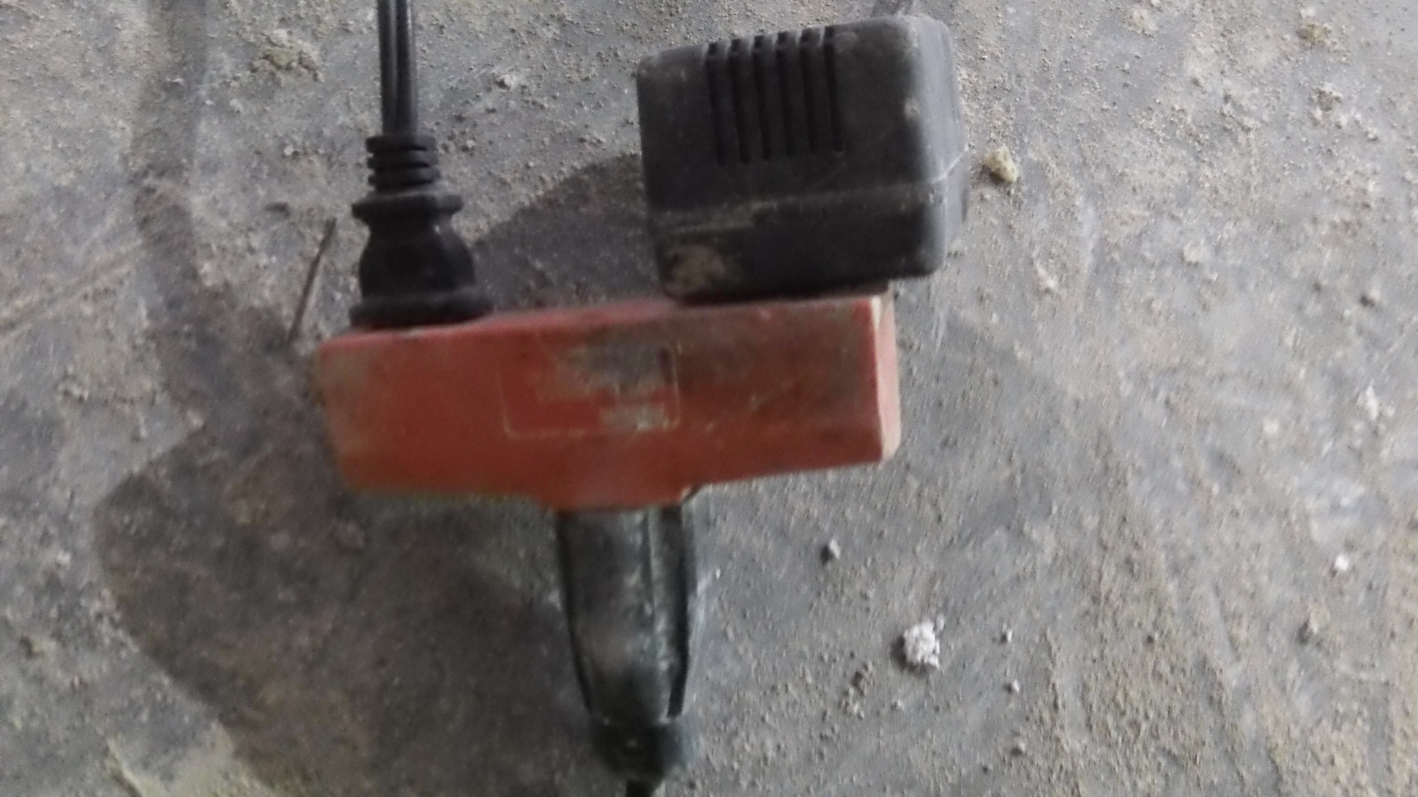
Electrical

Slide 57

Electrical Safety?

Slide 58
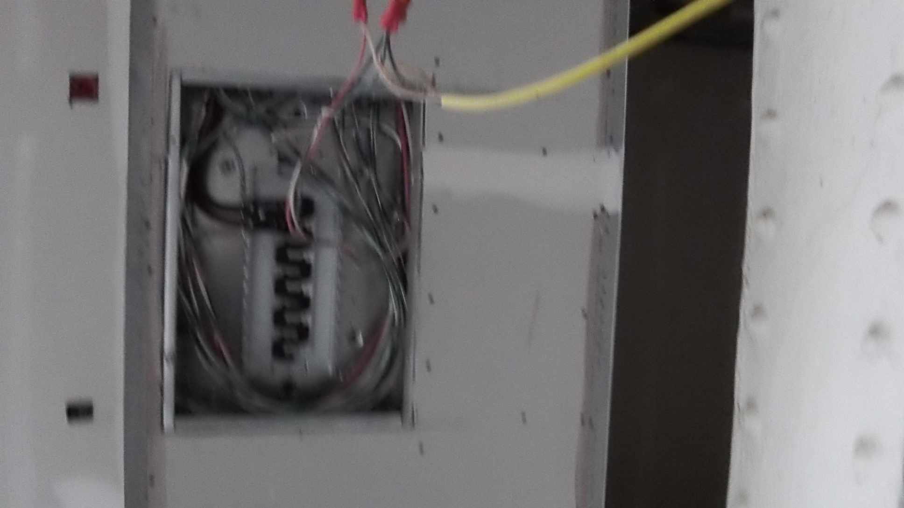
Electrical Safety?

Slide 59

Extension Cord on Job Site

Slide 60
Electrical (Wiring)
#5 On OSHA’s Top 10 Most Frequently Cited Standard for 2013
3,425 Violations (2013)
2,371 Violations (2012)
Problems with flexible cords and cables
Boxes and temporary wiring
Poor use of extension cords
Use of temporary wiring as permanent wiring

Slide 61
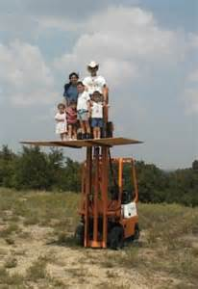
I Guess We Missed the Last Training Class!!

Slide 62
Powered Industrial Truck
Training:
  Combination of formal instruction (lecture, discussion, interactive computer learning, video tape, written material)
  Practical training (demonstrations performed by the trainer and practical exercises performed by the trainee)
  Evaluation of the operators performance in the workplace

Slide 63
Powered Industrial Truck
Training and evaluation shall be conducted by persons who have the knowledge, training, and experience to train PIT operators and evaluate their competence.
Training Program Content – initial training
  Operating instructions, warnings, and precautions for the types of truck the operator will be authorized to operate;

Slide 64
Powered Industrial Truck
Workplace related topics
Refresher Training
  Operator vehicle in unsafe manner
  Involved in an accident or near miss incident
  Evaluation that operator is not operating the truck safely
  Assigned to drive different type of truck
  Condition in workplace changes affect safe operation of truck

Slide 65
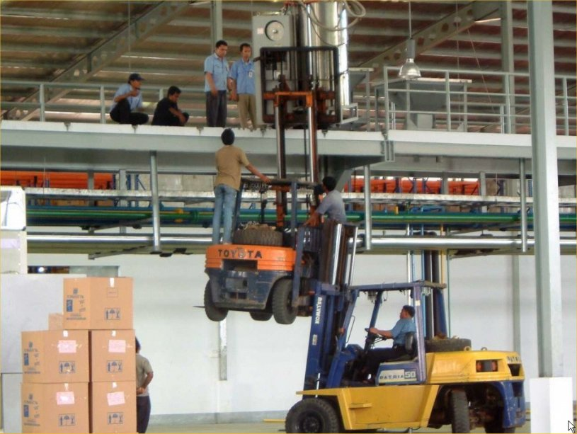
Excellent Training of Employees?

Slide 66
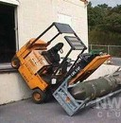
Need Retraining

Slide 67
Powered Industrial Truck
#6 on OSHA Top 10 Most Frequently Cited Standard for 2013
3,340 Violations (2013)
1,993 Violations (2012)
Inadequate operator training and refresher training
Poor condition of trucks when returned to service after repair

Slide 68
Ladders
Training requirements
The employer shall provide a training program for each employee using ladders and stairways, as necessary. The program shall enable each employee to recognize hazards related to ladders and stairways, and shall train each employee in the procedures to be followed to minimize these hazards.

Slide 69
Ladders
The employer shall ensure that each person has been trained by a competent person in the following areas, as applicable:
  The nature of fall hazards in the work area;
  The correct procedures for erecting, maintaining, and disassembling the fall protection systems to be used;
  The proper construction, use, placement, and care in handling of all stairways and ladders

Slide 70
Ladders
  The maximum intended load – carrying capacities of ladders and
  The standards contained in this subpart
  Retraining shall be provided for each employee as necessary so that the employee maintains the understanding and knowledge acquired through compliance with this section.

Slide 71
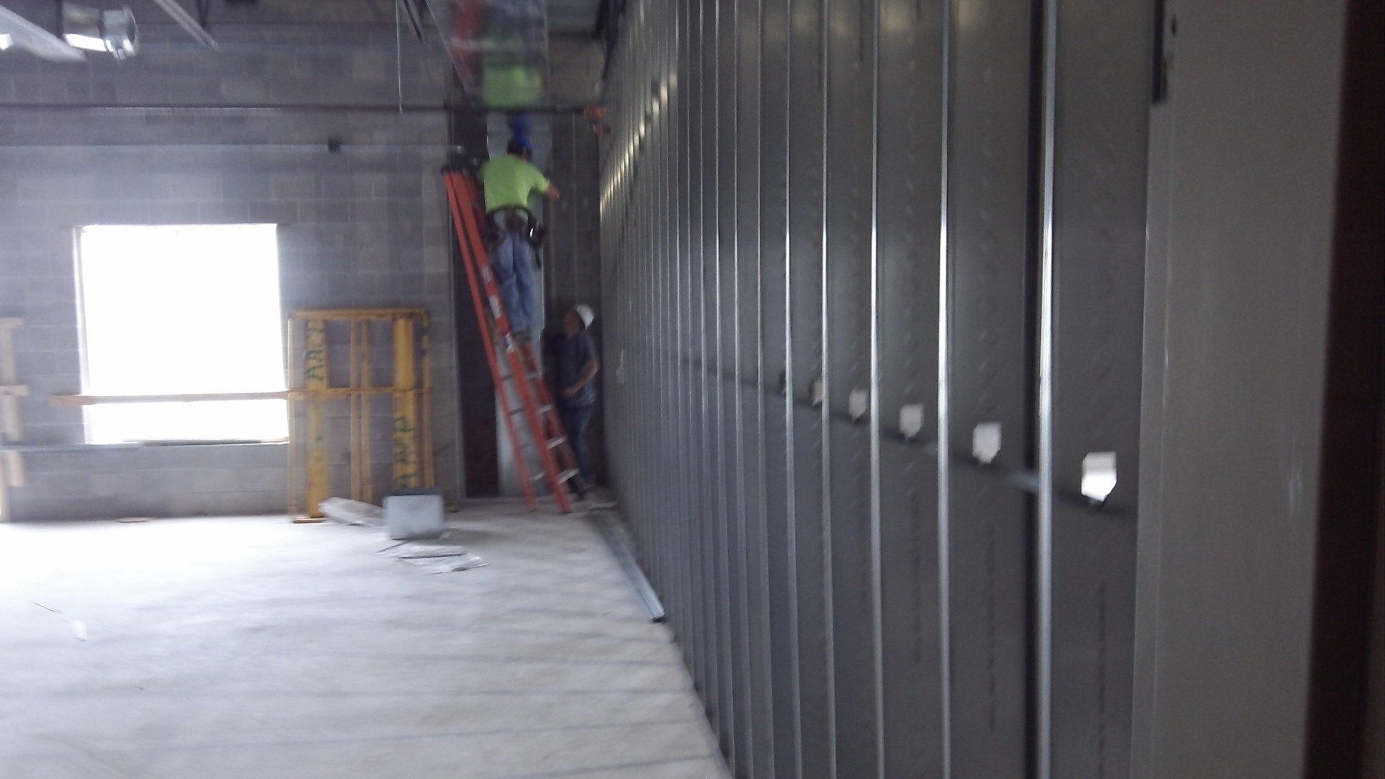
Step ladder in closed position

Slide 72
Extension Ladder Not Secured

Slide 73
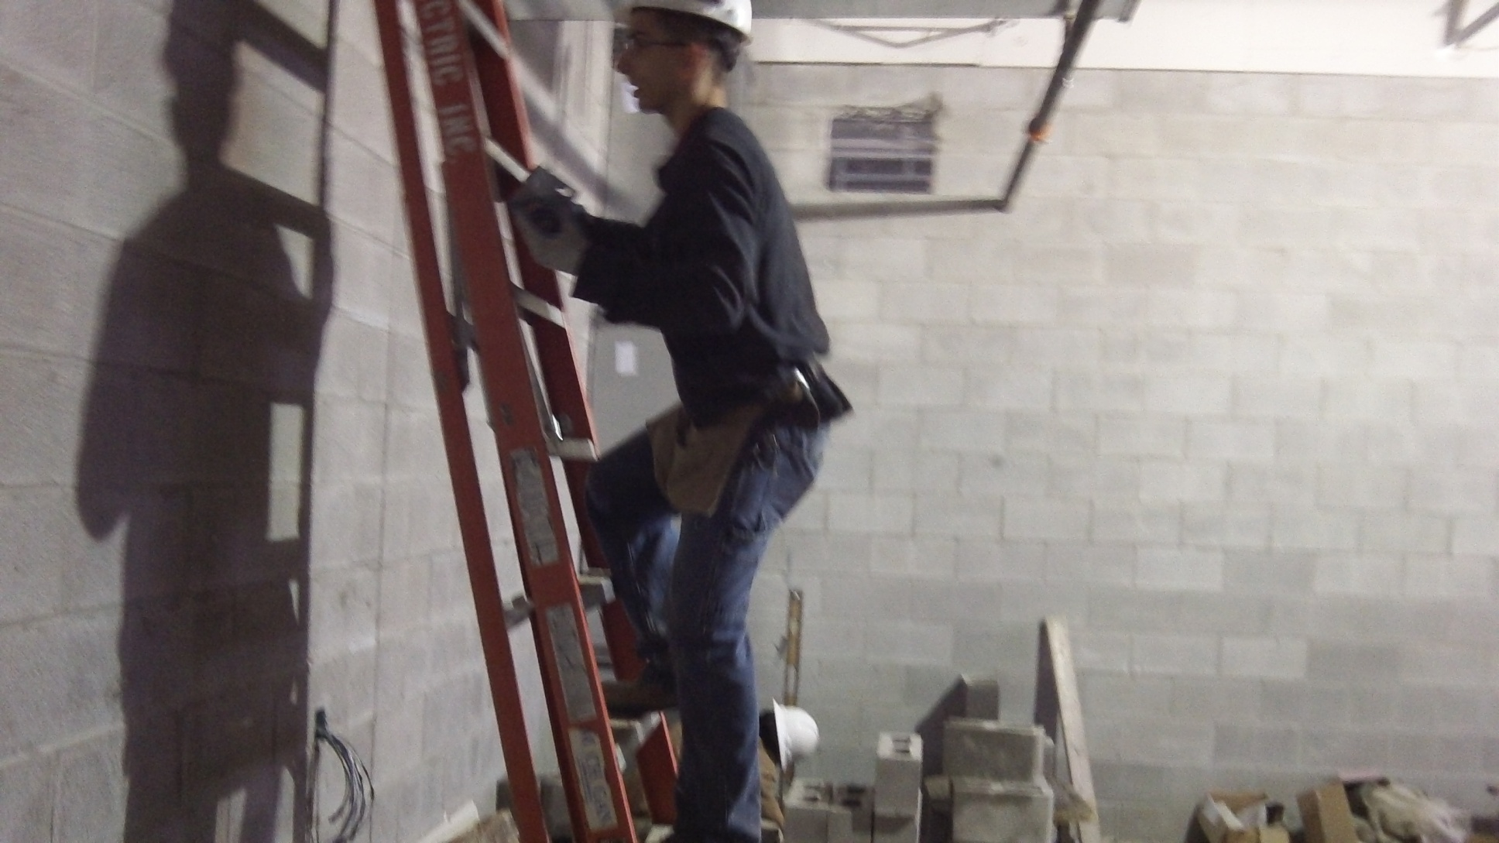
An Electrician working on Closed Step Ladder

Slide 74
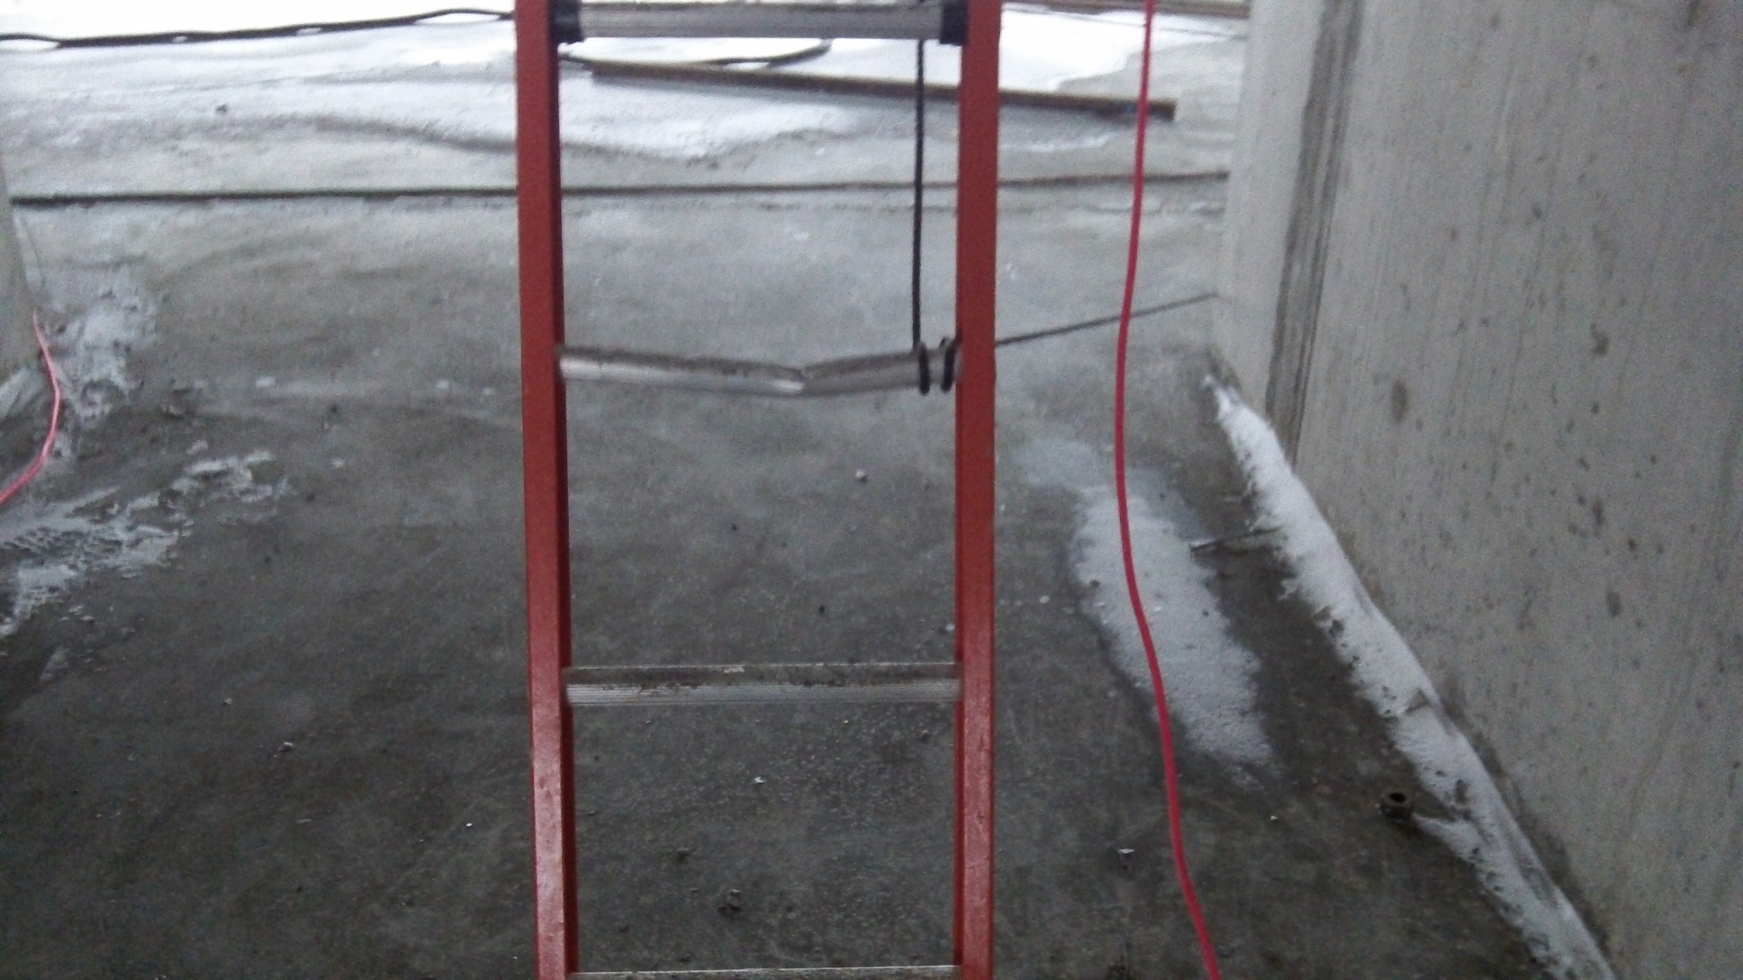
Ladder with Broken Rung

Slide 75
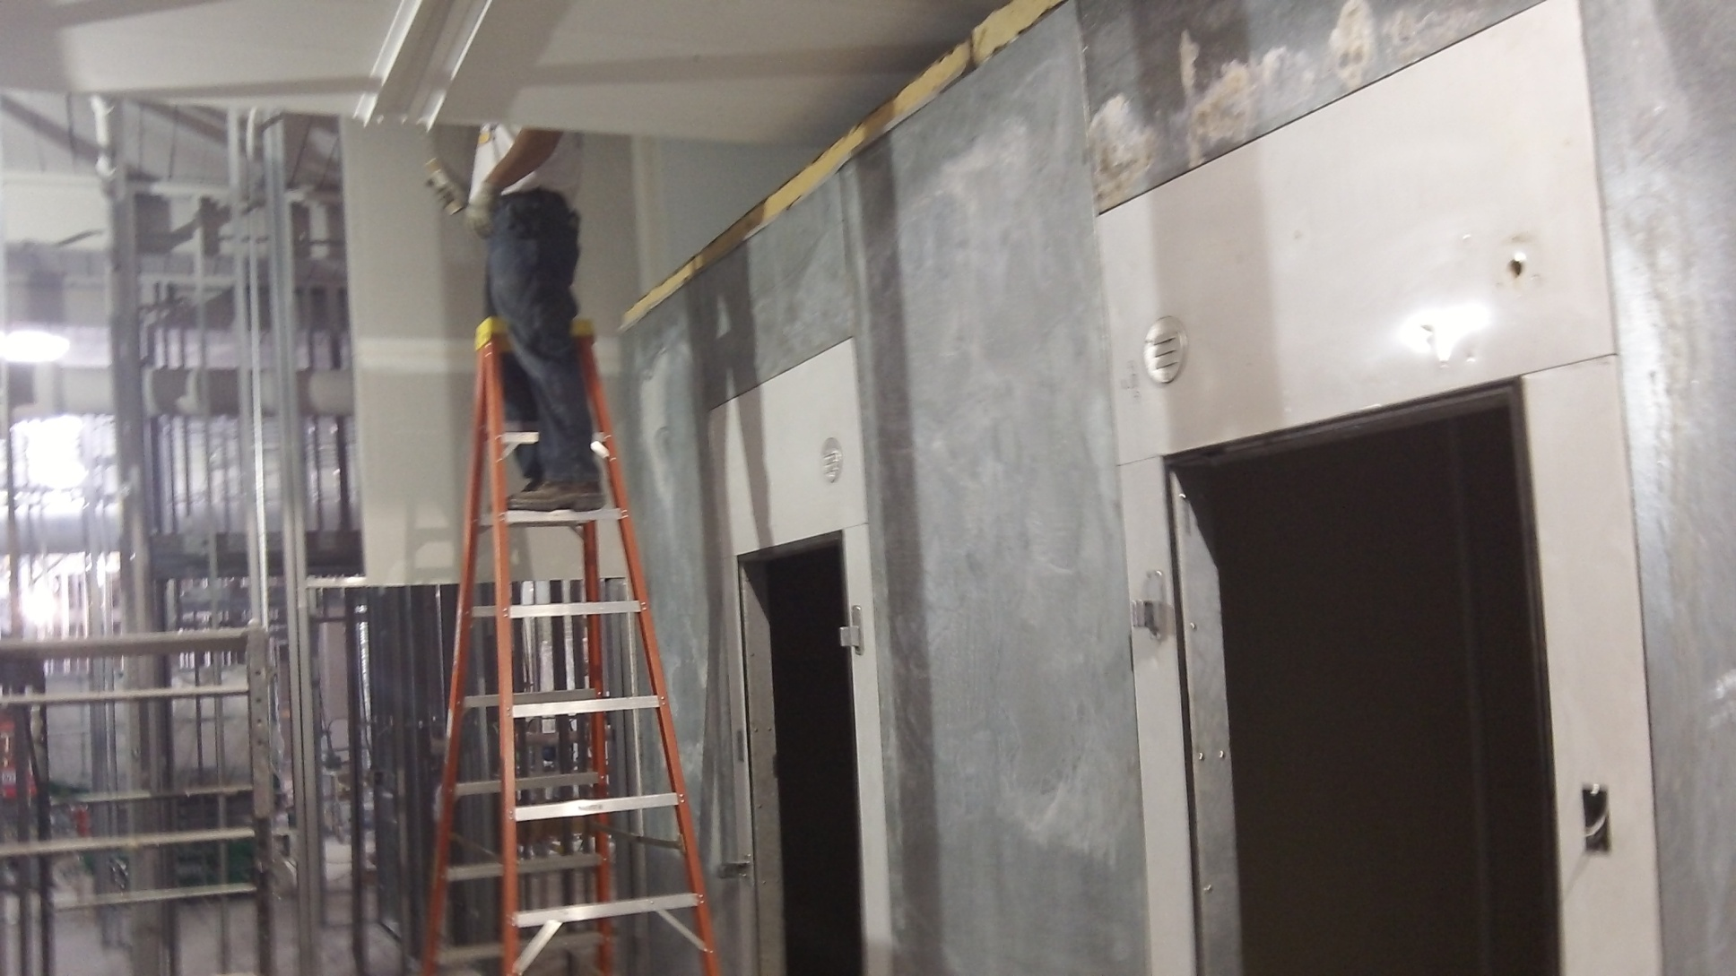
Step Ladder Use the Proper Side

Slide 76
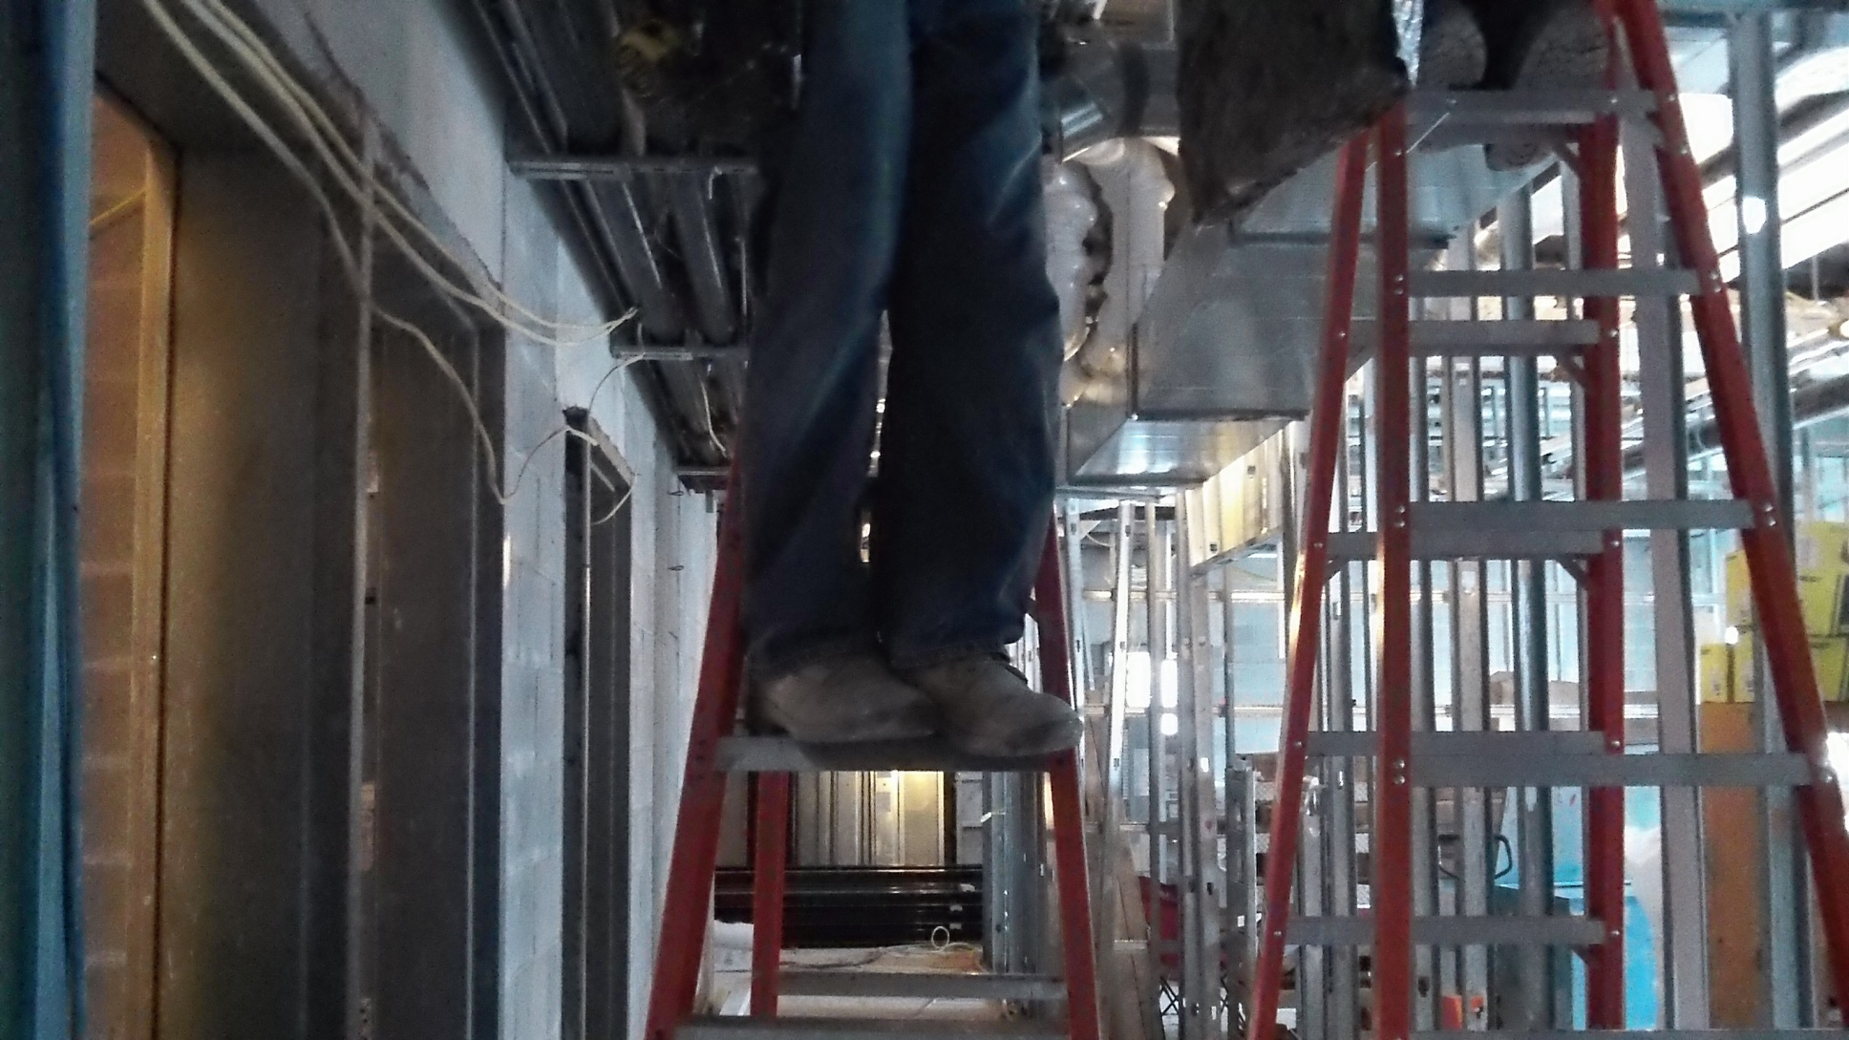
Standing the Wrong Way/On Top Step

Slide 77
Ladders
#7 on OSHA’s Top 10 Most Frequently Cited Standard for 2013
3,311 violations (2013)
2,310 violations (2012)
Damaged side rails
Using top ladder step
Using a ladder not suitable for the job
Placing excessive loads on ladders

Slide 78
Lockout/Tagout
Why training?
  So they understand the purpose of the energy control program
  So that employees acquire the knowledge and skills necessary for the safe application, usage and removal of the energy controls.

Slide 79
Lockout/Tagout
Different levels of training for three categories of employees:
  Authorized employees must receive training on recognition of:
    Applicable hazardous energy sources
    Type and magnitude of the energy available in the workplace
    Methods and means necessary for energy isolation and control

Slide 80
Lockout/Tagout
  Affected employees must receive training on the purpose and use of the energy control procedure
  Other employees (whose work activities are or may be in an area where energy control procedures may be utilized) must be instructed about the procedure and about the prohibition relating to attempts to restart or reenergize machines or equipment that are locked out or tagged out.

Slide 81
Lockout/Tagout
Training Requirements:
Frequency: No annual requirement for formal training once it has been given initially (at least annual mandatory “periodic inspection” involving reviews of energy control procedures that apply to job assignments.) When it should occur next occur is “event driven” and is addressed by 1910.147 (c) (7) (iii).

Slide 82
Lockout/Tagout
Reasons for retraining
  A change in job, equipment, or processes that present a new hazard
  A change in the energy control (lockout/tagout) procedures
  Evidence of deficiencies in knowledge or practice (e.g., at the periodic inspections.)

Slide 83
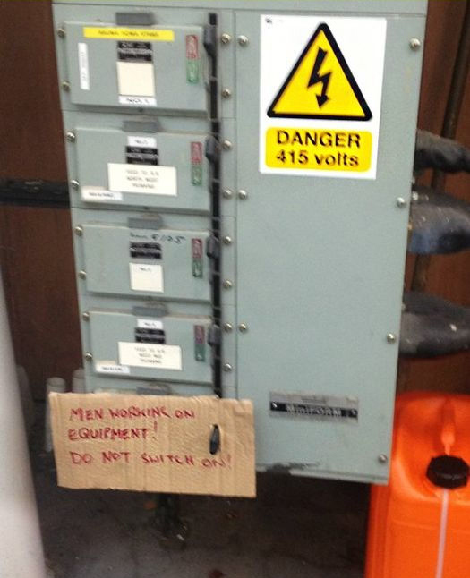
Poor Lockout/Tagout Procedures

Slide 84
Control of Hazardous Energy
Lockout/Tagout
#8 on OSHA’s Top 10 Most Frequently Cited Standard for 2013
3,254 violations (2013)
1,744 violations (2012)
Poor or no energy control procedures
Inadequate worker training

Slide 85
Electrical
Training is for the worker to understand the hazards associated with energized electrical work and earn the designation as being qualified.
Hazards –
  Potential electrical shock
  Arc flash and thermal burns
  Arc blast

Slide 86
Electrical
In addition, qualified persons to receive training to be familiar with:
  The proper use of special precautionary techniques
  PPE including arc-flash suit selection, use and limitations
  Insulating and shielding materials
  Insulating tools and test equipment

Slide 87
Electrical
Additional Training and Retraining
  If the person is observed to not be following the rules and regulations, i.e., the safety-related work practices.
  If new technology, or new types of equipment or changes in procedures necessitate the use of safety-related work practices that are different from those the employee normally uses.
  If the employee must use safety-related work practices that are not customarily used during their regular job duties.

Slide 88
Electrical
  If an employee who has been trained to perform a task has not performed that task in more than 1 year.
  Retraining shall be performed not to exceed three (3) years.
  CPR training
  AED training
  First Aid
  Contacting emergency personnel

Slide 89
Electrical Safety Principles
It’s Just 40 Little Words
Plan every job
Anticipate unexpected events
Identify the hazard
Minimize the hazard
Use procedures as tools
Use the correct tools for the job task
Use personal protective equipment
Isolate the equipment
Assess people’s abilities
Protect the person
Audit these principles

Slide 90
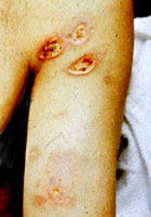
Arc Flash Burn

Slide 91
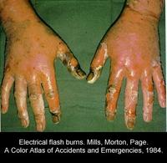
Electrical Flash Burns

Slide 92
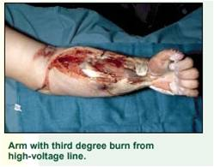
What Happens When You Are Working HOT

Slide 93
Electrical
# 9 on OSHA’s Top 10 Most Frequently Cited Standard for 2013
2,745 violations (2013)
1,572 violations (2012)
Electrical Shock
Electrocution Exposure

Slide 94
Machine Guarding
Thorough operator training should involve instruction or hands-on training in the following areas;
- Parts and functions of the machine
- Basic operator controls
- Operator responsibilities

Slide 95
Machine Guarding
Safe guarding:
  A description and identification of the hazards associated with the machine
  How to use safeguards and why
  How and under what circumstances safeguards can be removed, and by whom (repair or maintenance personnel only)
  What to do (contact the supervisor) if a safeguard is damaged, missing, or unable to provide adequate protection

Slide 96
Machine Guarding
This training is necessary for new operators and maintenance or setup personnel, when any new or altered safeguards are put into service, or when workers are assigned to a new machine or operation.

Slide 97
Machine Guarding
#10 on OSHA’s Top 10 Most Frequently Cited Standard for 2013
2,701 violations (2013)
1,332 violations (2012)
Point of operations exposure
Inadequate or no anchoring of fixed machinery
Exposure to blades

Slide 98
References
Concise Guide to Workplace Safety and Health Gary Chambers
The OSHA Training Answer Book, 2nd Edition Mark Moran
OSHA website
National Safety Council

Slide 99
Questions
Safety Compliance Associates, LLC
OSHA/PERRP Compliance
Health and Safety Training
OSHA Construction Outreach
Safety Audits/ On-site Safety Inspections
Executive Development
440.479.1539
Website: safetycomplianceohio.com

